Slide 1

AI-Driven Hotel Revenue Analytics
POWER BI
PYTHON (MACHINE LEARNING)
KAGGLE DATASET

Slide 2





Meet the Team
SAMRUDDHI NAKATE
Data Modeling
M BINDU SRI
Revenue optimization
Module
PAVAN KUMAR
Guest Insights
Module
TIRTH MADANE
Forecasting Module
KRISHNARJUN
Strategy &
Optimization Module
Mentor
Jayashri

Slide 3




Power BI Dashboards
Interactive visualizations for key insights.
PROJECT
OVERVIEW
Key Performance Indicators
Track critical metrics for hotel performance.
AI-Powered Forecasting
The dashboard enables performance monitoring, pricing optimization, customer segmentation, and future demand forecasting to support data-driven strategic decisions and sustainable revenue growth
Predict future trends with machine learning.
Customer Clustering
Identify valuable guest segments for targeted strategies.
| Presented by: Group A

Slide 4

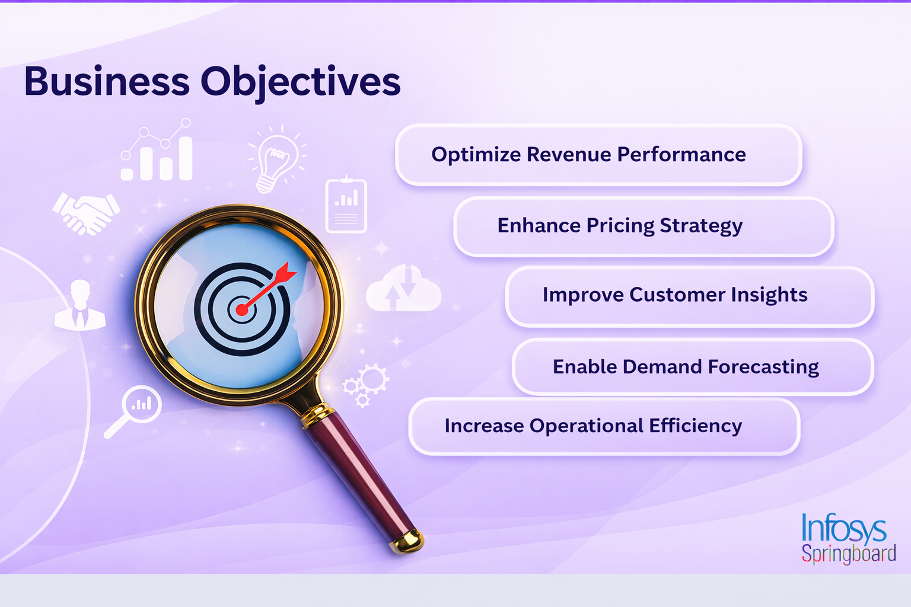
Optimize Revenue Performance
Enhance Pricing Strategy
Improve Customer Insights
Enable Demand Forecasting
Increase Operational Efficiency

Slide 5


Solution Architecture
Power BI Dashboard
From Raw Data to Insights
ML Forecasting
Data Modeling
Data Cleaning
Data Source

Slide 6
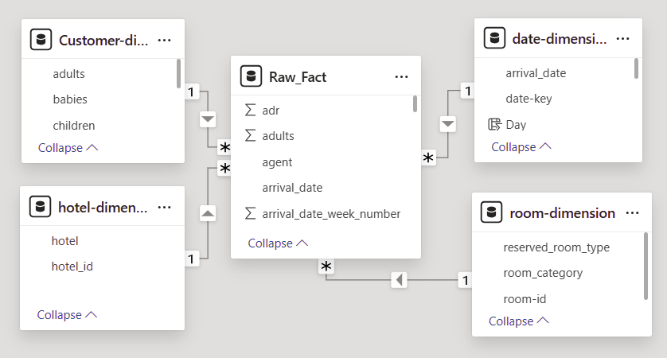
Data Modeling
The Foundation of Analytics
Fact Table
Central table capturing key transactional data
Dimension Tables
Provide descriptive attributes for the fact table,

Slide 7
26M
Revenue
Total Revenue
Overall income generated from all hotel
operations.
71.17%
Occupancy
Occupancy Rate
Percentage of available rooms that are sold.
KPI Metrics
102.00
ADR
Key performance indicators measuring hotel occupancy, pricing efficiency, and revenue performance.
ADR (Average Daily Rate)
Average rental income per occupied room per day.
0.37
Cancellation Rate
Percentage of bookings that were canceled. It helps evaluate booking stability and demand reliability.
Cancellation
Rate

Slide 8
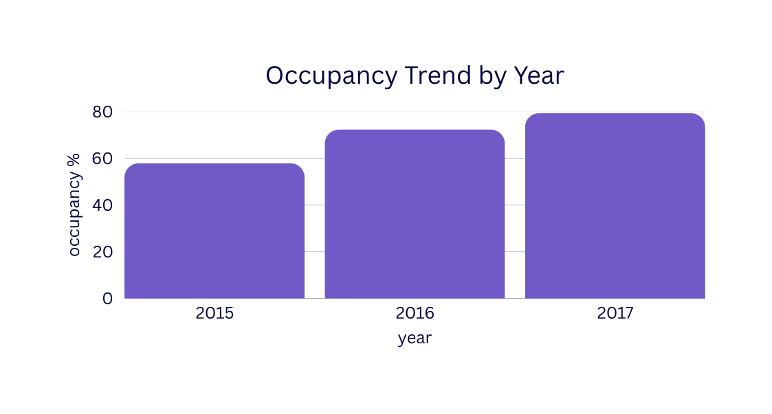
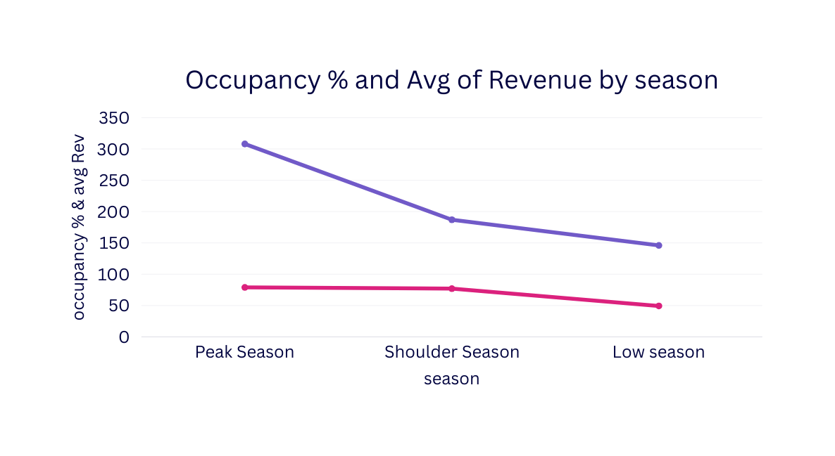
Occupancy
Trend Analysis

Slide 9
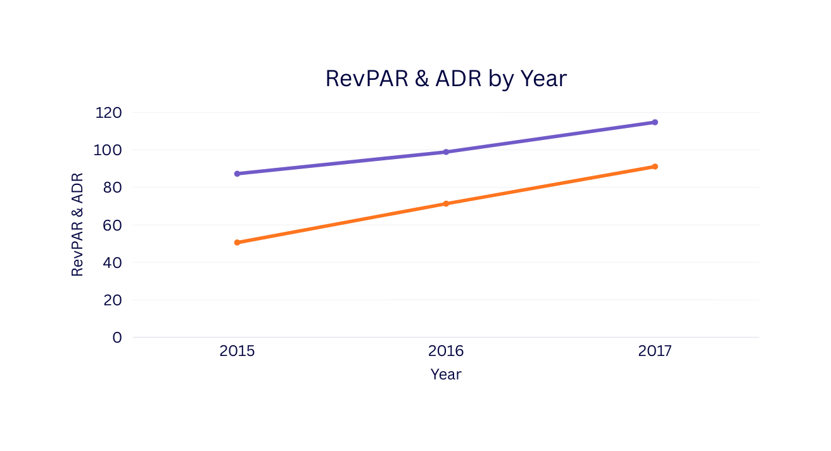
Revenue Performance: ADR & RevPAR
ADR (Average Daily Rate):
Focuses on the price achieved per sold room.
RevPAR (Revenue Per Available Room):
Combines occupancy and average rate, offering a holistic measure of revenue-generating efficiency.
Trends in ADR and RevPAR directly reflect the effectiveness of pricing strategies and demand management over time.

Slide 10

Guest Demographics & Segmentation
Understanding who our guests are helps tailor marketing efforts and enhance personalized experiences.
Country-wise Distribution
Identify primary source markets and adjust international outreach.
Market Segments
Analyze leisure, corporate, group, and other booking types.
Customer Type
Distinguish between transient, repeat, and new guests.
Booking
Channels
Evaluate performance of direct bookings, OTAs, and other platforms.

Slide 11
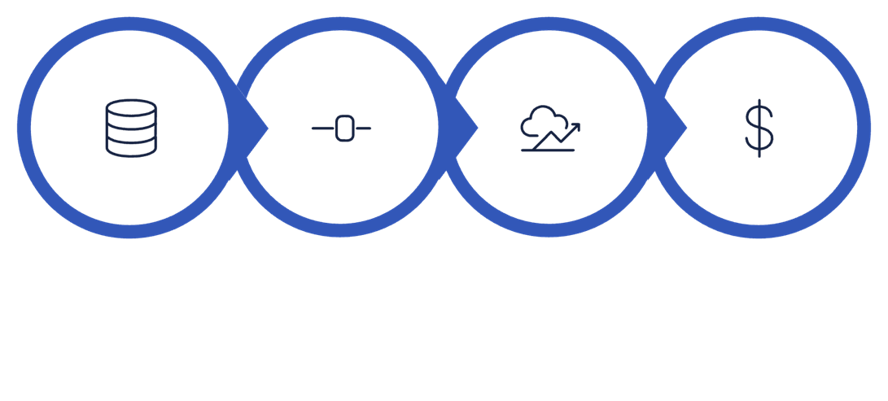
Forecasting & Cancellation Analysis
Deep dive into demand prediction and cancellation patterns.
Identified Aug 2019 as peak forecast month
Total forecast bookings ≈ 1.40K
Overall Cancellation Rate: 0.37
Higher cancellations observed in Couple & “solo” guest types
Data Ingestion
Feature Prep
Prophet Model
Revenue Prediction
Average Lead Time: 104
Longer lead time bookings show higher cancellation probability

Slide 12
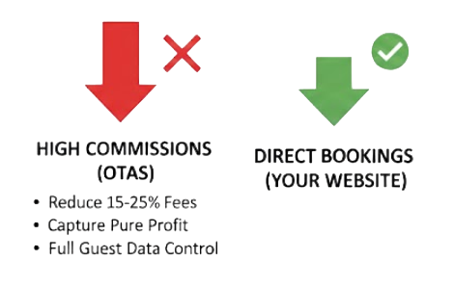
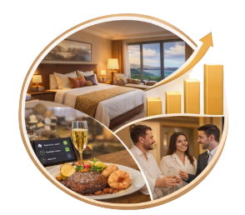

Strategic Recommendations
Channel & Segment Optimization Focus on high RevPAR channels (TA/TO, Online TA) Reduce dependency on low-contributing segments Promote direct bookings to improve margins
Upselling & Revenue Expansion Leverage special request data for meal and room upgrades Promote premium room categories during peak season Implement personalized offers for repeat guests
Cancellation Risk Control High lead time shows higher cancellation risk → introduce partial deposit policyTarget Family & “Other” segments with stricter cancellation termsOffer incentives for non-refundable bookings

Slide 13

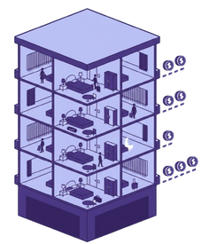



Dashboard Components
Exploring the essential elements of our executive dashboard.
Occupancy & Revenue Analysis
Tracks Occupancy, ADR, and RevPAR to evaluate room utilization and revenue efficiency.
Guest Analysis
Profiles demographics, loyalty, and booking sources to understand customer behavior.
Forecast
Predicts future demand via time-series modeling to guide pricing and staffing decisions.
Pricing & ADR Analysis
Evaluates pricing trends across seasons and segments to optimize revenue strategy.
Strategy Analysis
Identifies
upsell opportunities and segment profitability to drive sustainable growth.
Booking & Cancellation Analysis
Monitors booking patterns and cancellations to stabilize demand and minimize loss.

Slide 14
Conclusion & Future Scope
Conclusion
The project transformed raw hotel data into actionable insights using Power BI and forecasting techniques. It enables better pricing decisions, performance tracking, and strategic revenue planning.
Future Scope
The system can be enhanced with AI-based dynamic pricing, advanced cancellation prediction models, and real-time data integration for smarter decision-making.

Slide 15
Thank You
Thank you for your ongoing support

